Slide 1
The Legend of the Cat People
An Engineering Perspective of the 80s Chick-Lit Sensation by Margit Sandemo (with Cat Memes)
Dr. Helga Ingimundardóttir June 15th 2023

Slide 2
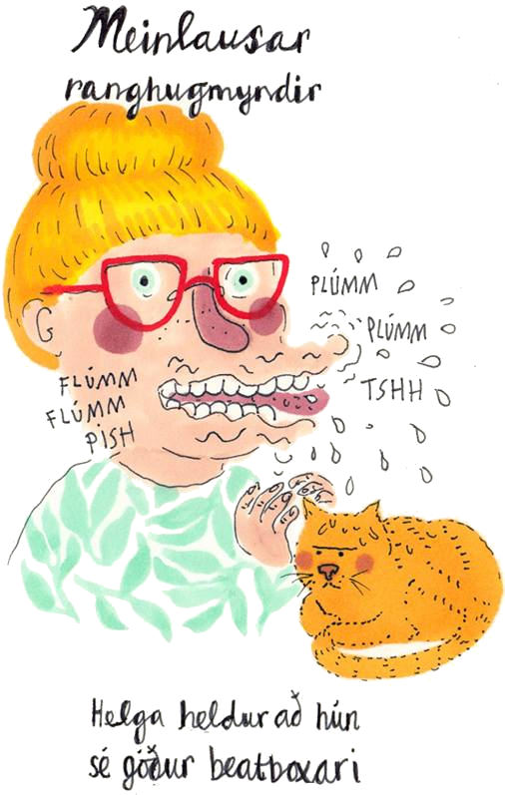

Dr. Helga
Internet Cat-lady since 2012
IRL Cat-lady since 2017
PhD in Computational Engineering
Podcast host and producer of ÍSKISUR (2016-2020)
Previously Research Scientist at deCODE Genetics, Data Scientist at CCP Games and Head of AI Research at Travelshift
Currently working as a Postdoc at the University of Iceland
@tungufoss on Twitter
by Lóaboratoríum*
*not commissioned, but befitting

Slide 3

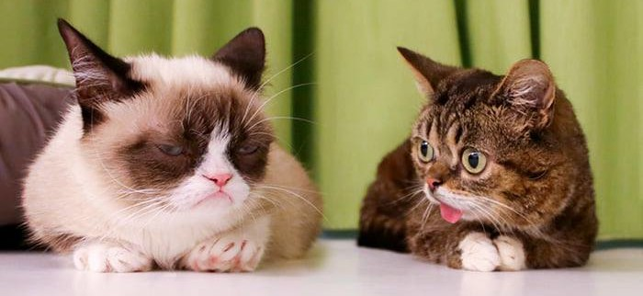
About ÍSKISUR
A literary and feline entertainment podcast*
Discuss the erotic and surreal book series The Legend of the Ice People by Margit Sandemo
Each episode covers part of a book from the series and concludes with a segment on internet cats
Birna, Kristín, and dr. Helga
*None of the hosts are actually cats or literary experts.
via @iamlilbub
Grumpy Cat first meeting Lil Bub Internet Cat Festival, 2013
3

Slide 4
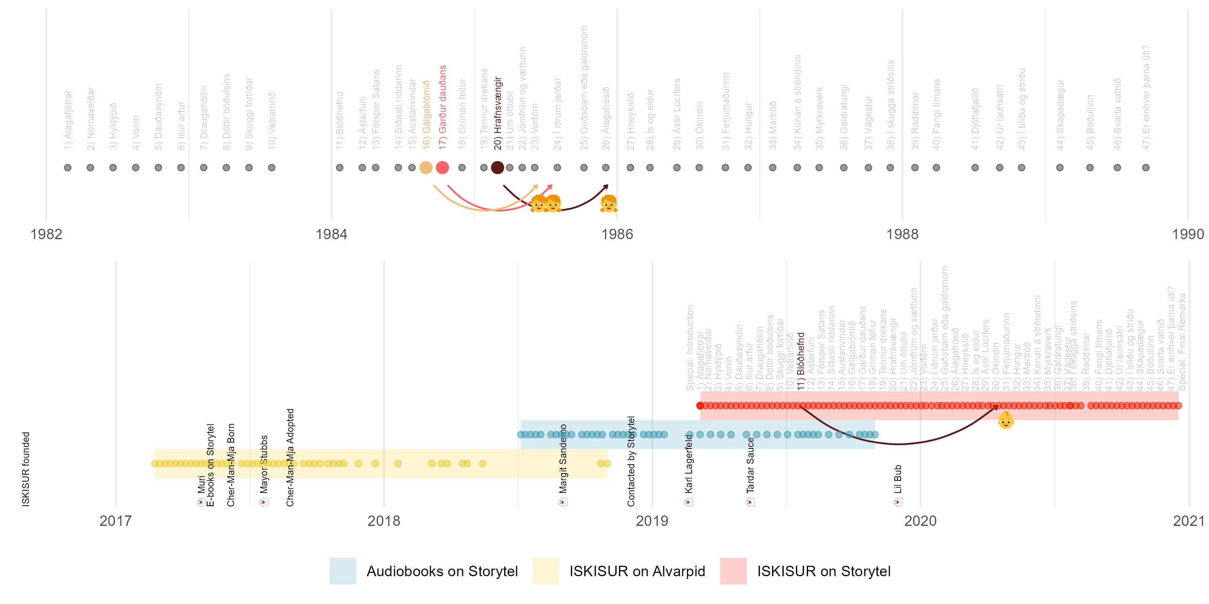
Timeline for the Legend of the Ice Cat-People
4

Slide 5
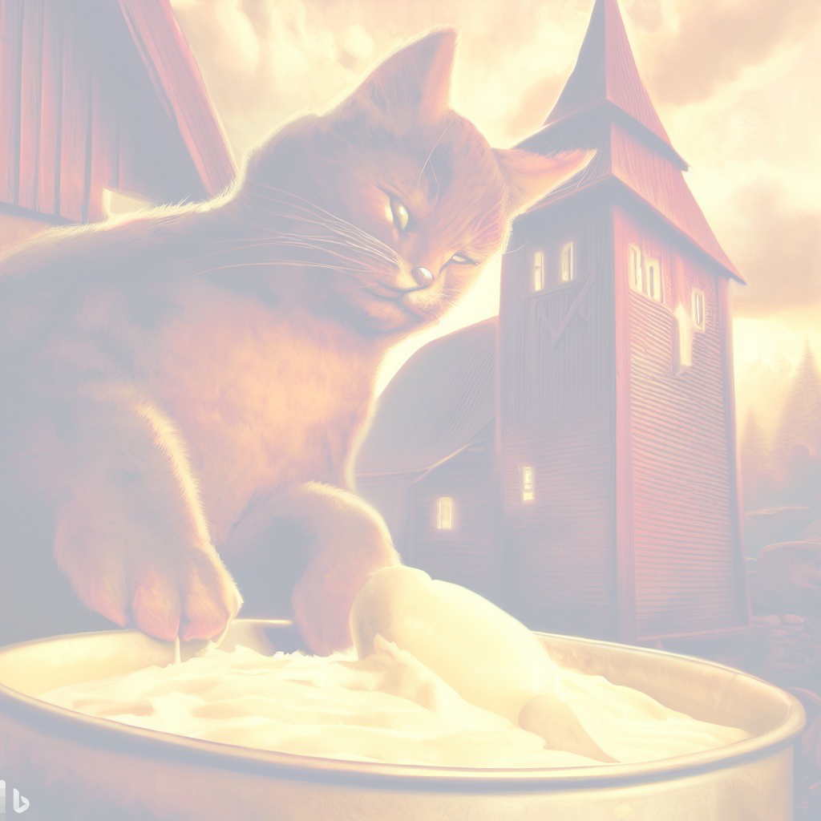
The Book Series in the 80s

Slide 6
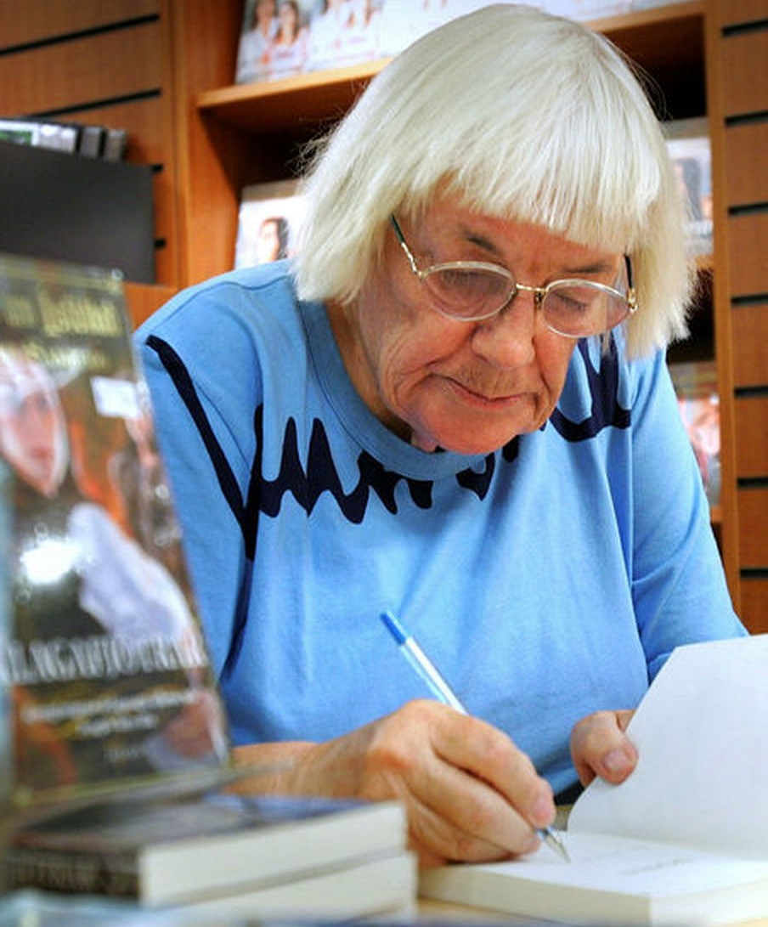
Margit Sandemo, 1924–2018
Norwegian-Swedish author
Father was a Norwegian poet, Anders Underdal
Claimed lineage to Nobel Prize-winning author Bjørnstjerne Bjørnson
First published at forty years old
Best-selling author in the Nordic countries since the 1980s
Notable Book Series | Years | n
The Legend of the Ice People | 1982–89 | 47
The Warlock | 1991–94 | 15
The Legend of the Realm of Light | 1995–99 | 12
mbl.is/Þorvaldur Örn Kristmundsson
Margit signing Álagafjötrar in Eymundsson, 2007

Slide 7
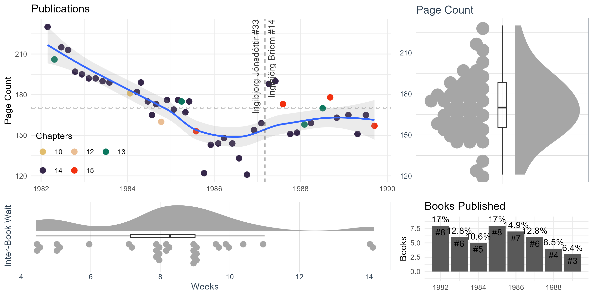
Publications
47 books, 652 chapters, 8,023 pages, 8 years
Average book length: 170 pages (avg. 13.9 chapters)
Released 1 book every 2 months (avg. 57.9 days), usually on Tue.

Slide 8
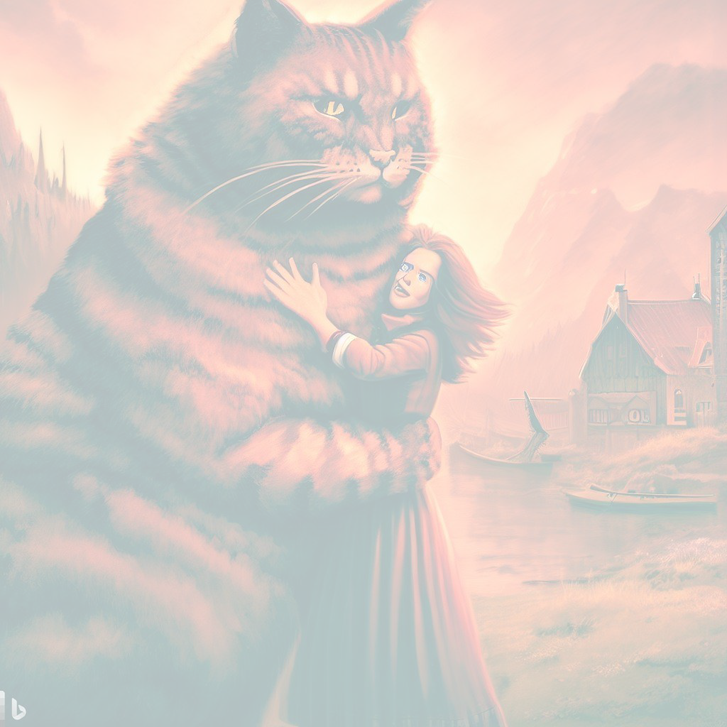
The Ice People

Slide 9
Ice People Family Tree
Unknown
Sunniva
−1581
Þengill Silja
1548−1621 1564−1621
Unknown
Charlotte 1556−1620
Unknown Sunna 1579−1602
Ari Meta
1586−1660 1587−1635
Líf Dagur
1583−1668 1581−1637
Sunniva Tarald Þorgeir Cornelia Þrándur Brandur Matthildur Tarald Yrja Alexander Cecilie 1601−1621 1601−1660 1607−1635 1616−1635 1608−1625 1609−1686 1610−1672 1601−1660 1601−1669 1595−1671 1602−1683
Kolgrímur 1621−1635
Mikael Anette
1635−1708 1634−1684
Andrés Elí Matthías Hildur Þráinn Jessika Kaleb Gabríella 1627−1711 1638−1690 1624−1695 1627−1693 1628−1678 1629−1681 1618−1695 1628−1712
Dominic Villimey
1652−1730 1656−1730
Nikulás Irmelín
1655−1713 1655−1712
Örjen Lene Tristan Unknown Villimey 1649−1712 1652−1724 1658−1741 1656−1730
Þengill Sigrid Úlfur Berit 1677−1760 1679−1755 1677−1742 1678−1724
Sören Christiana
1663−1710 1677−1756
Úlfhéðinn Elísa
1674−1771 1674−1747
Madeleine Dan Ingiríður 1699−1770 1697−1769 1698−1789
Anna Vendill
1694−1776 1694−1775
Unknown
Jón Brynja
1696−1768 1697−1763
Unknown
Daníel Unknown 1717−1773
Örjen 1723−1780
Unknown
Mar Shira Úlfur Þóra 1712−1790 1716−1790 1724−1788 1720−1790
Sölvi Unknown 1749−1779
Ólafur Ingela
1750−1791 1752−1830
Arfur 1748−1832
Vibekka
−1770
Vermundur Elísabet
1745−1791 1750−1791
Heikir Vinga
1774−1848 1777−1848
Óli Sara
1773−1813 1769−1815
Christer Kajsa Erlendur Gunnhildur Vinga 1774−1853 1779−1818 1773−1845 1775−1847 1777−1848
Eskill Sólveig
1797−1858 1788−1855
Kolur Anna
1799−1859 1796−1860
Unknown
Dóratea 1800−1860
Unknown
Tómas Þula
1795−1848 1800−1848
Viljar Belinda
1820−1899 1830−1900
Lúcífer
Saga 1836−1861
Unknown
Emma 1825−1880
Unknown
Petra Christer Magdalena 1829−1870 1818−1893 1820−1895
Annelí Henning Agneta Úlfar Unknown 1853−1872 1850−1942 1848−1915 1861−1883
Marco 1861−
Unknown
Knútur 1850−1889
Unknown
Unknown
Gerður Per Malin 1855−1888 1841−1913 1842−1916
Sander 1868−1937
Benedikta 1872−
Tamlin
Vanja Lindeló
1884−1910 1879−1897
Imri
Unknown
Erling 1884−
Unknown
Unknown
Petra 1880−1899
Unknown Christoffer Marit
1874−1946 1872−1945
André 1892−
Mali 1894−
Abel 1893−
Christa 1910−
Gandur
Knútur 1909−
Unknown
Mali barn Vetle
1894− 1899−1899 1902−
Hanna 1902−
Ríkharður 1913−
Vinnie Nataníel
1909− 1933−
Ellen 1938−
Óli 1918−
María Jónatan
1922− 1924−
Elísabet 1929−
Jóakim Karina
1920− 1926−
Þúfa 1937−
Christel Marianna
1942− 1943−
Jörgen 1944−
Mads 1945−
Oddur Finnur Óli
1946− 1946− 1947−
Gróa Gabriel
1948− 1948−
9

Slide 10
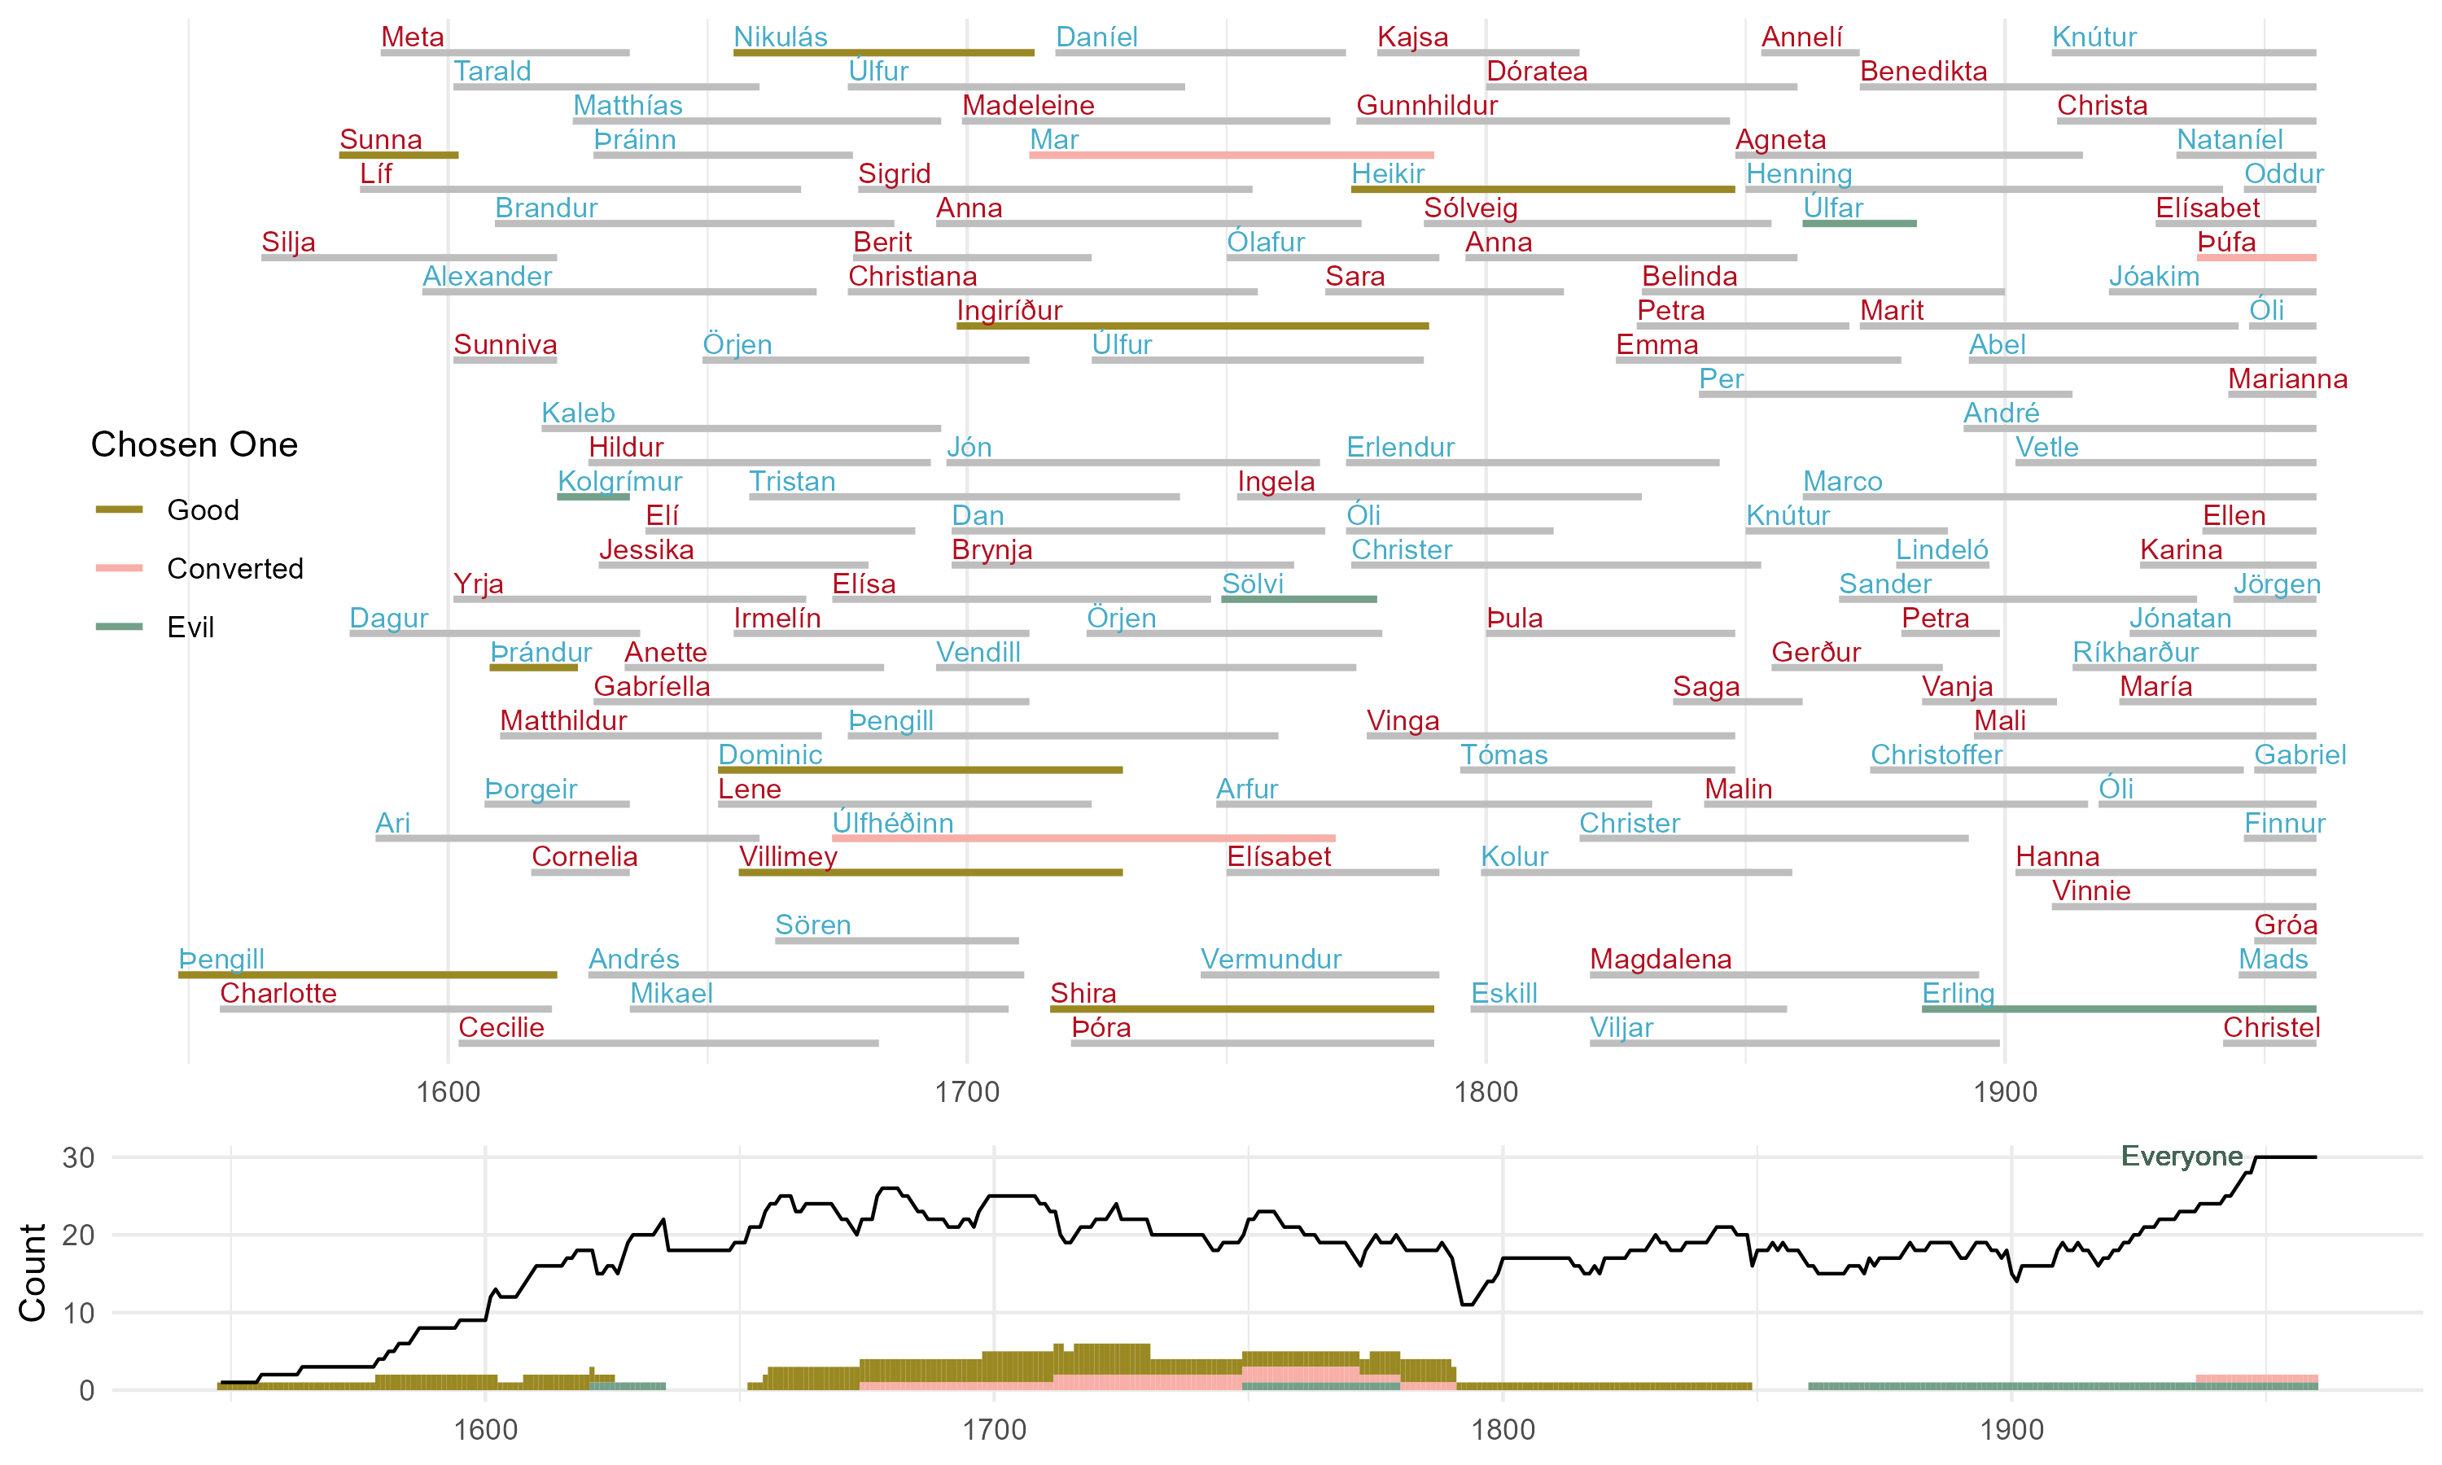
Ice People Family Gantt Chart

Slide 11
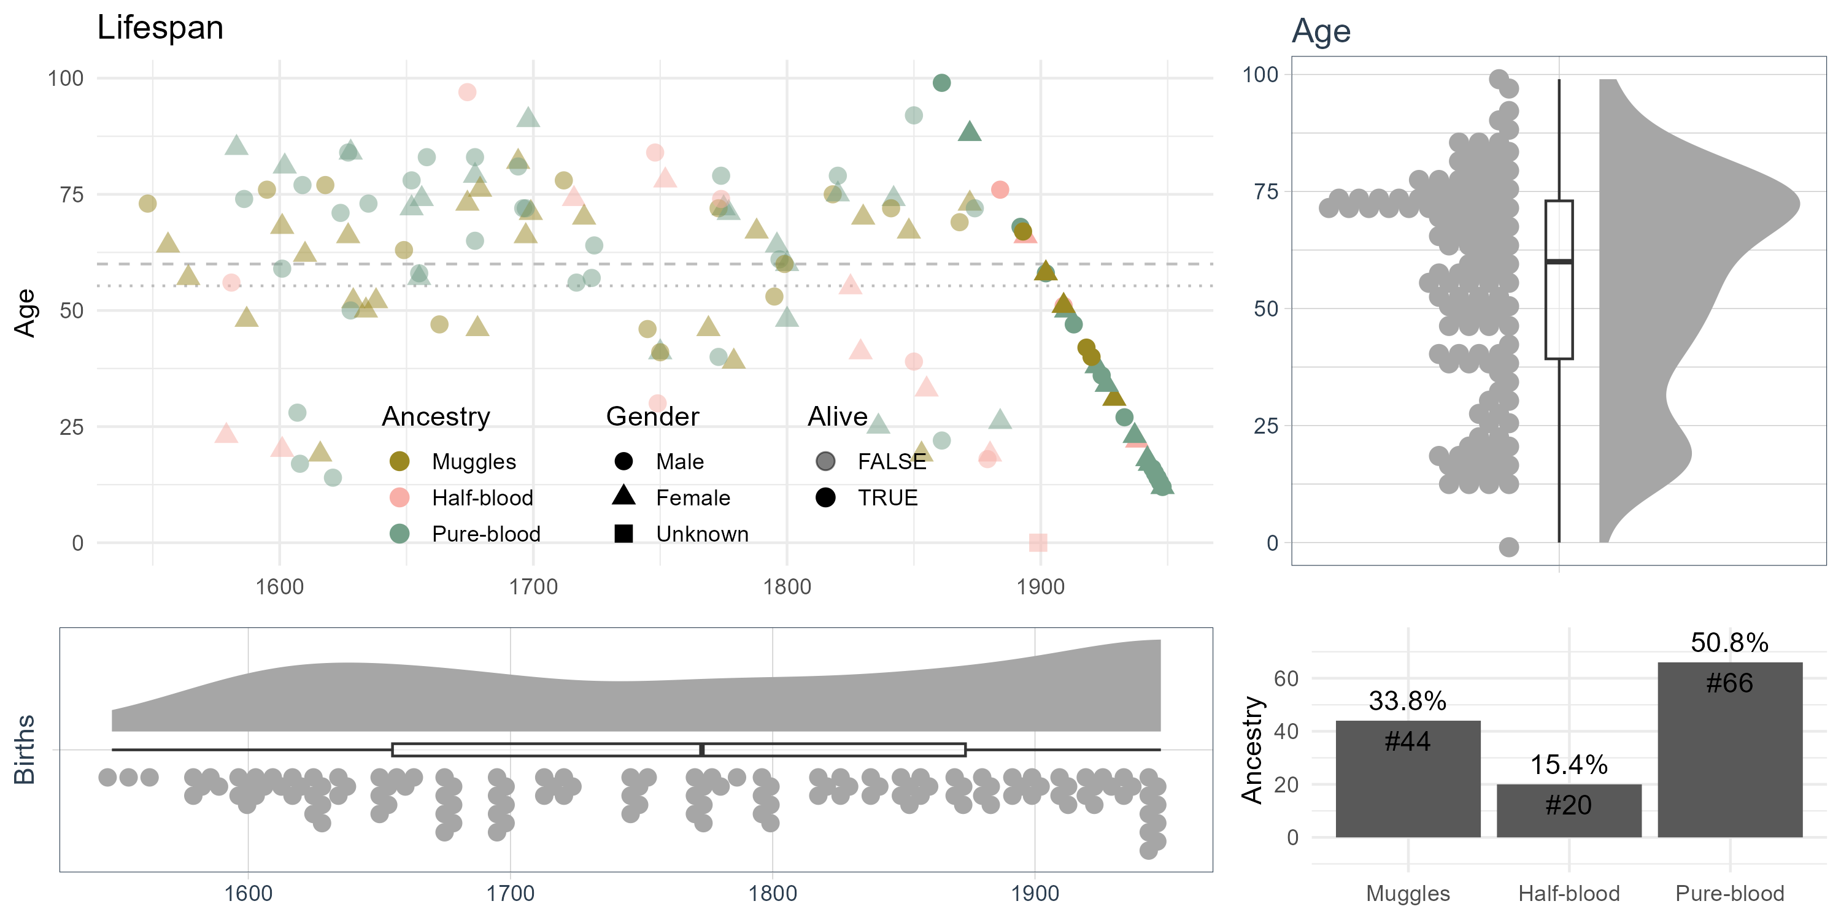
Lifespan of the Ice People
Average woman lives 58.5 years (median 65, n = 50)
Average man lives 62.5 years (median 71, n = 49)
1 centenarian, 4 people live to 90, 14 live to 80, 46 live to 70

Slide 12
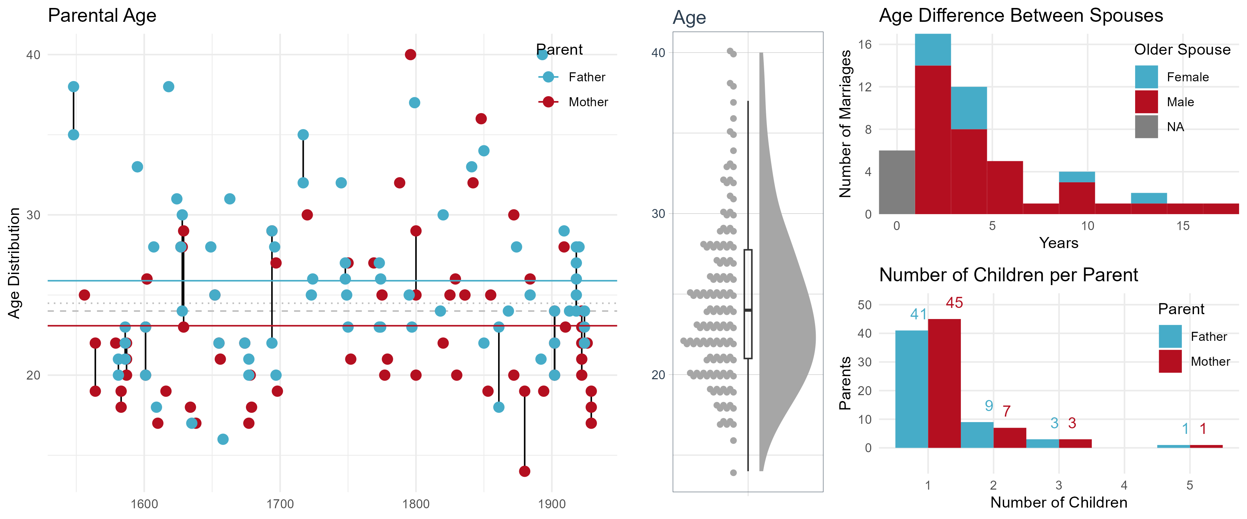
Parental Age at Birth and Spouce Age Difference
53 relationships described, 66 children born
85% of marriages have an older husband, age difference generally 3 years (max 17 years)
Average age of mother at childbirth is 23.5 years (fathers 26.0)
• 22 kids have either no father (n = 10) or no mother (n = 12)
12

Slide 13
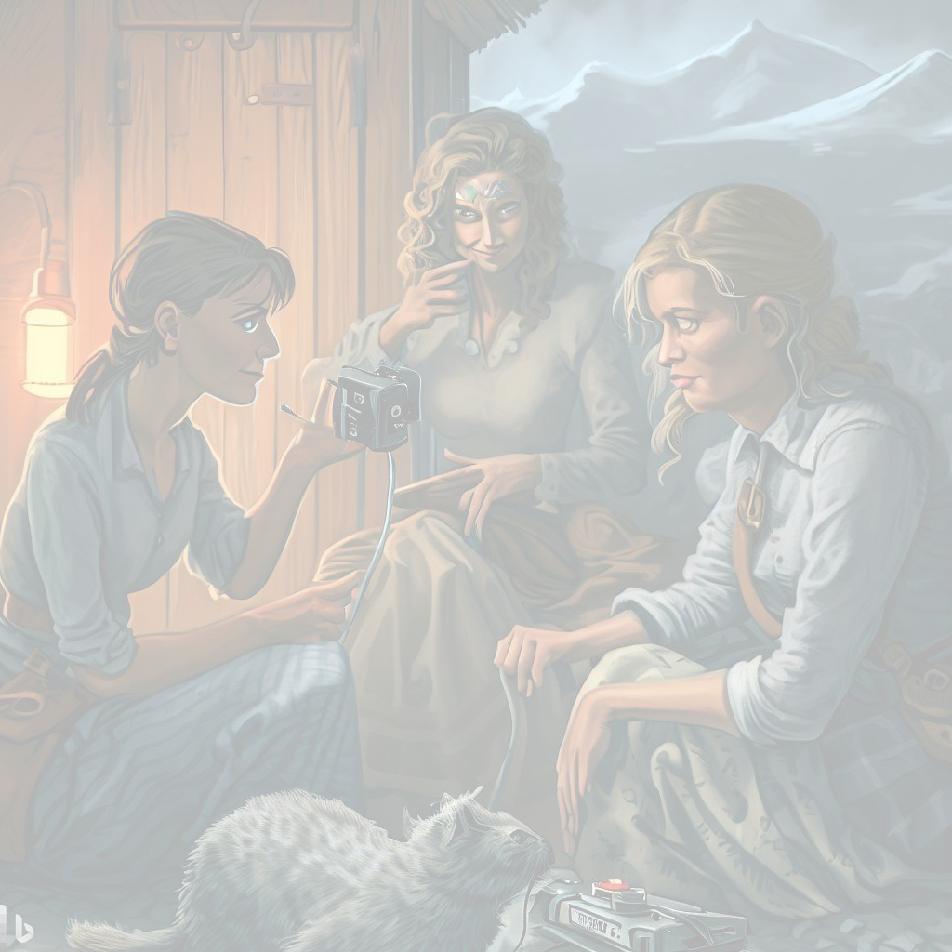
A Syndicated Book Club

Slide 14
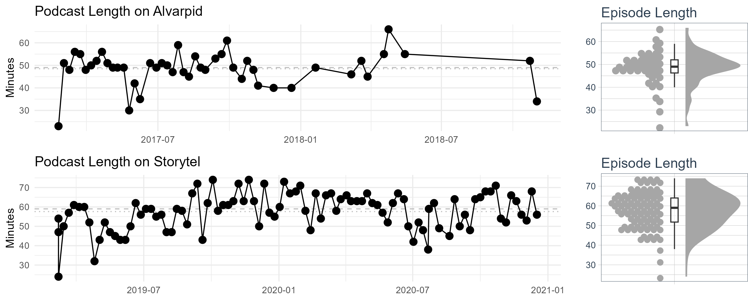
Podcast: Hours Rambled
Over a period of 45.8 months, there is 7,762 minutes of quality
content, or 5.4 days of continuous listening.
Average length is 57.6 minutes on Storytel (48.5 on Alvarpið), but never surpassing 75 minutes.

Slide 15
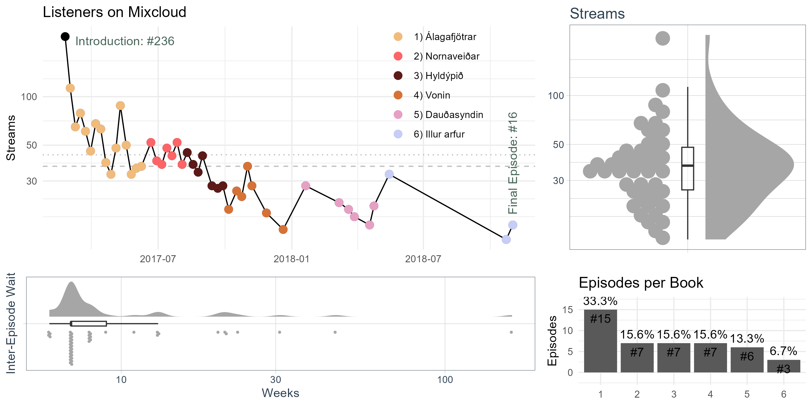
Podcast on Alvarpið: Listenership on nutiminn.is
46 episodes, 20 months, 5.5 books
2,231 minutes – 37 hours – 1.5 days of continuous listening
Roughly 1,040 streams per episode (thereof 40 in browser)

Slide 16
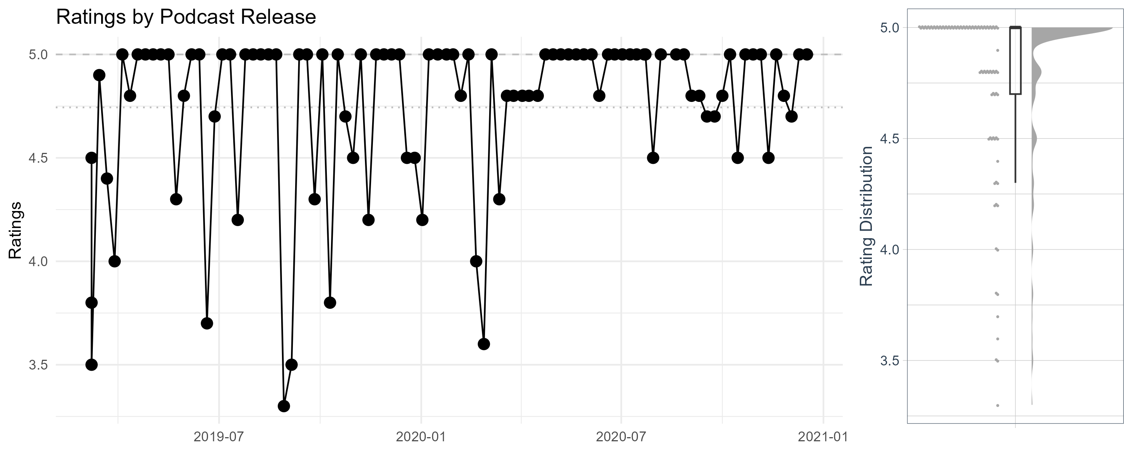
Podcast on Storytel: High Ratings
Average rating: 4.74 out of 5
54 episodes with a perfect 5.0 score (56% of total)
Only 4 episodes with a rating below 4.0 (worst case 3.3)

Slide 17
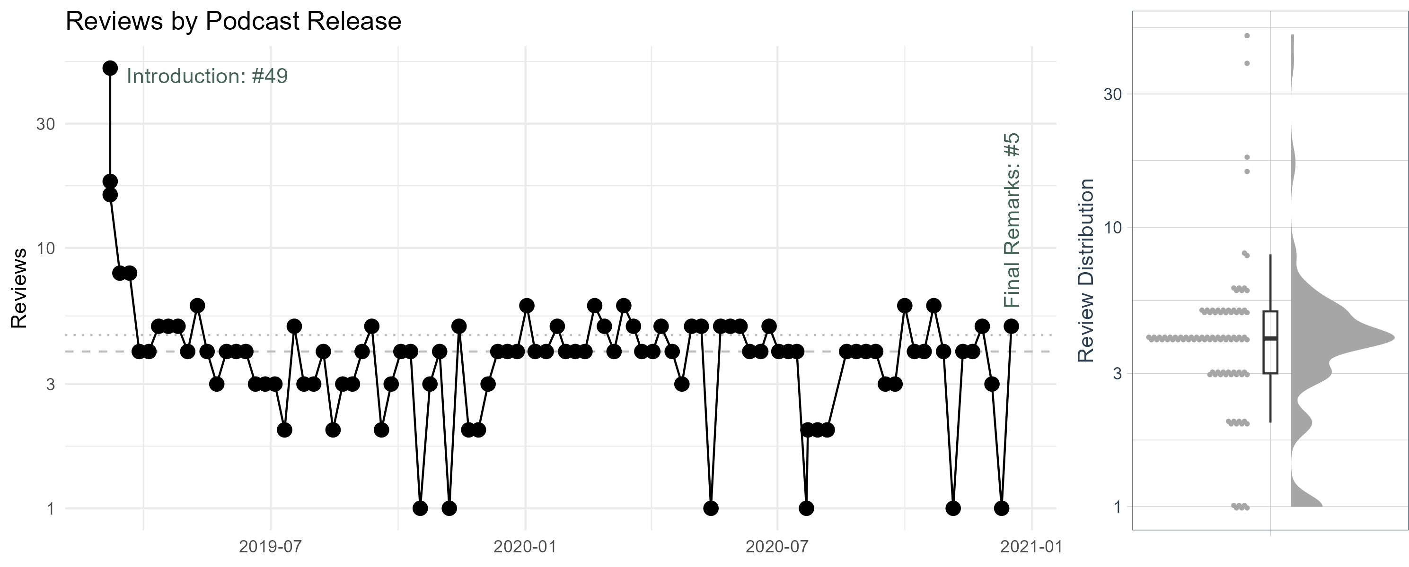
Podcast on Storytel: Low Reviews
Number of reviews: 444 total (25,627 for the audiobooks)
At least one active fan throughout the period
Four regular fans who consistently provided review

Slide 18
Podcast Platform Comparison
Total Running Time (hours)
Average Length (min)
Median Days to Next
Average Days to Next
Max Days to Next
Months Active
Episodes
Books
Alvarpið | 46 | 6 | 37.2 | 48.50 | 7 | 13.69 | 161 | 20.3
Storytel | 96 | 47 | 92.2 | 57.61 | 7 | 6.85 | 14 | 21.4
142 129.4
*4.1 months hiatus between Alvarpið and Storytel
45.8*

Slide 19
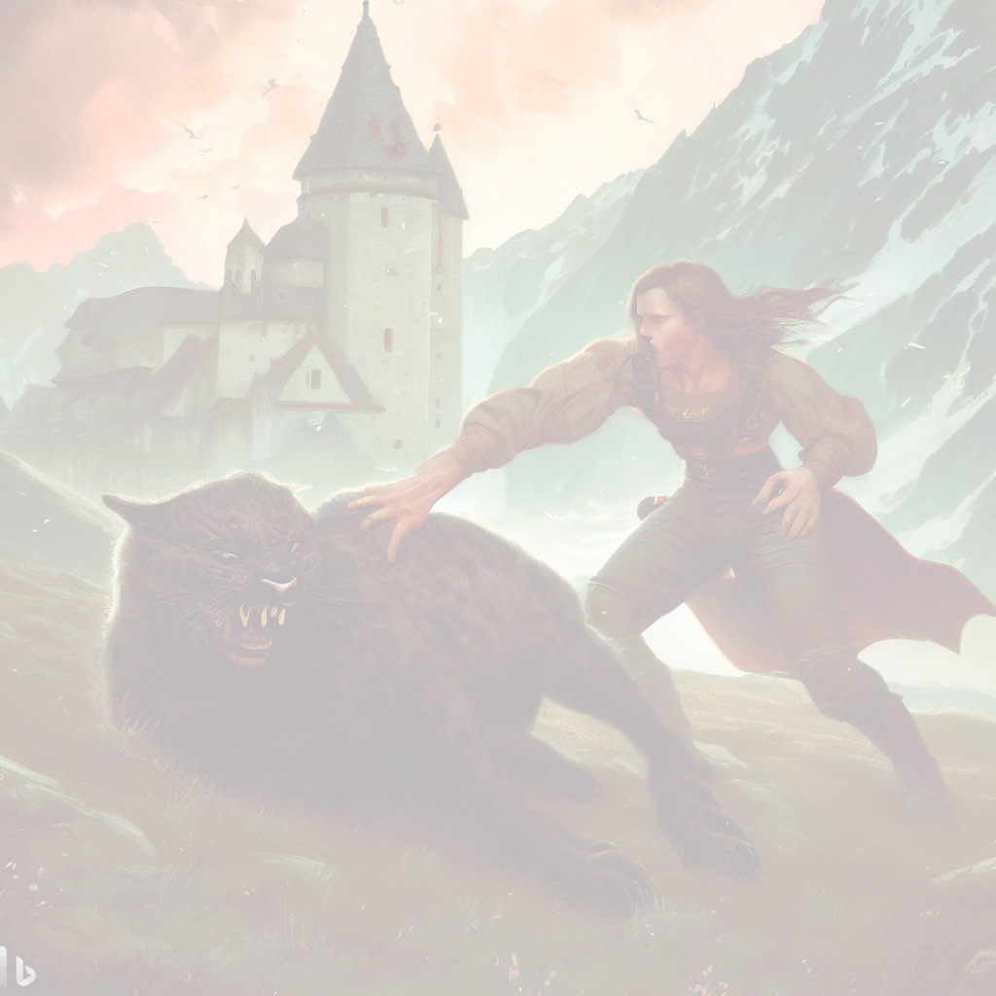
Audiobooks on Storytel

Slide 20
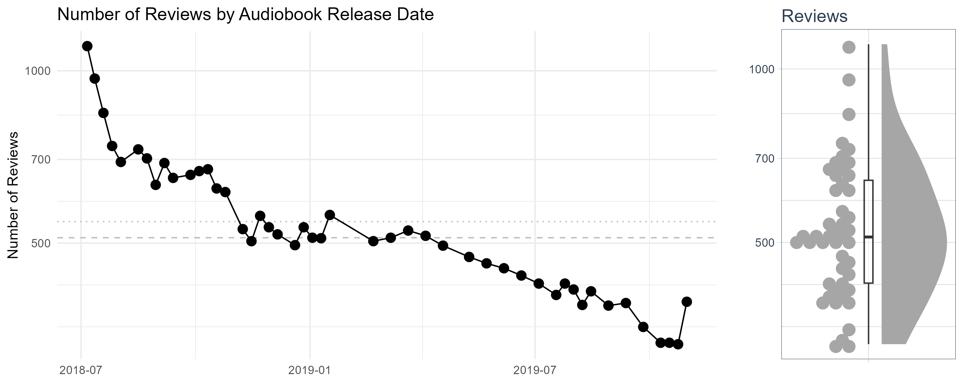
Audiobooks on Storytel: Active Fanbase
The series has a dedicated fanbase, with consistently high engagement.
A solid median review count of 511, and minimum of 333. Releases on Thursdays, spaced 1–2 weeks apart, over 16-months.

Slide 21
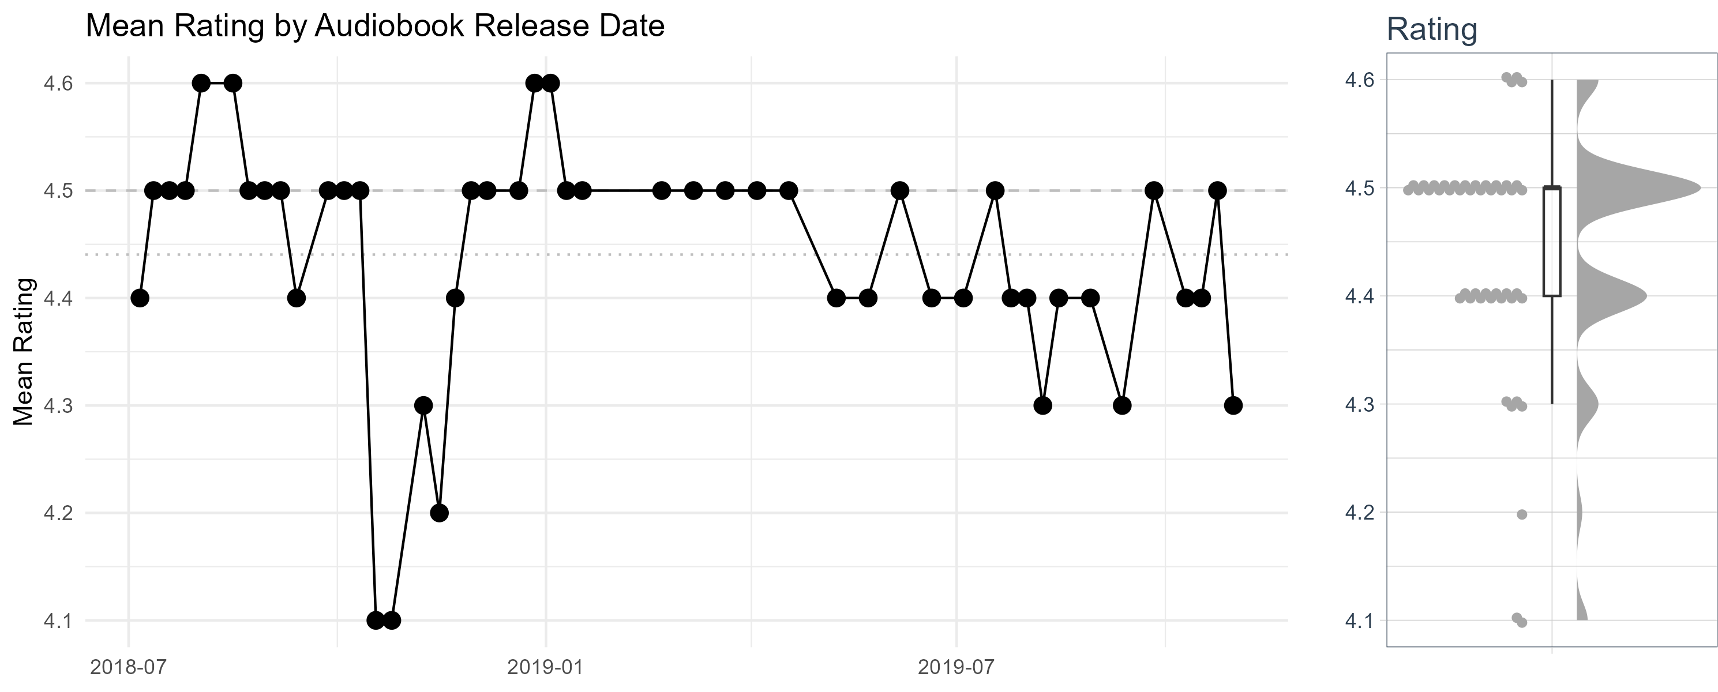
Audiobooks on Storytel: High Ratings
Overall high rating, an average 4.44 stars out of 5.

Slide 22
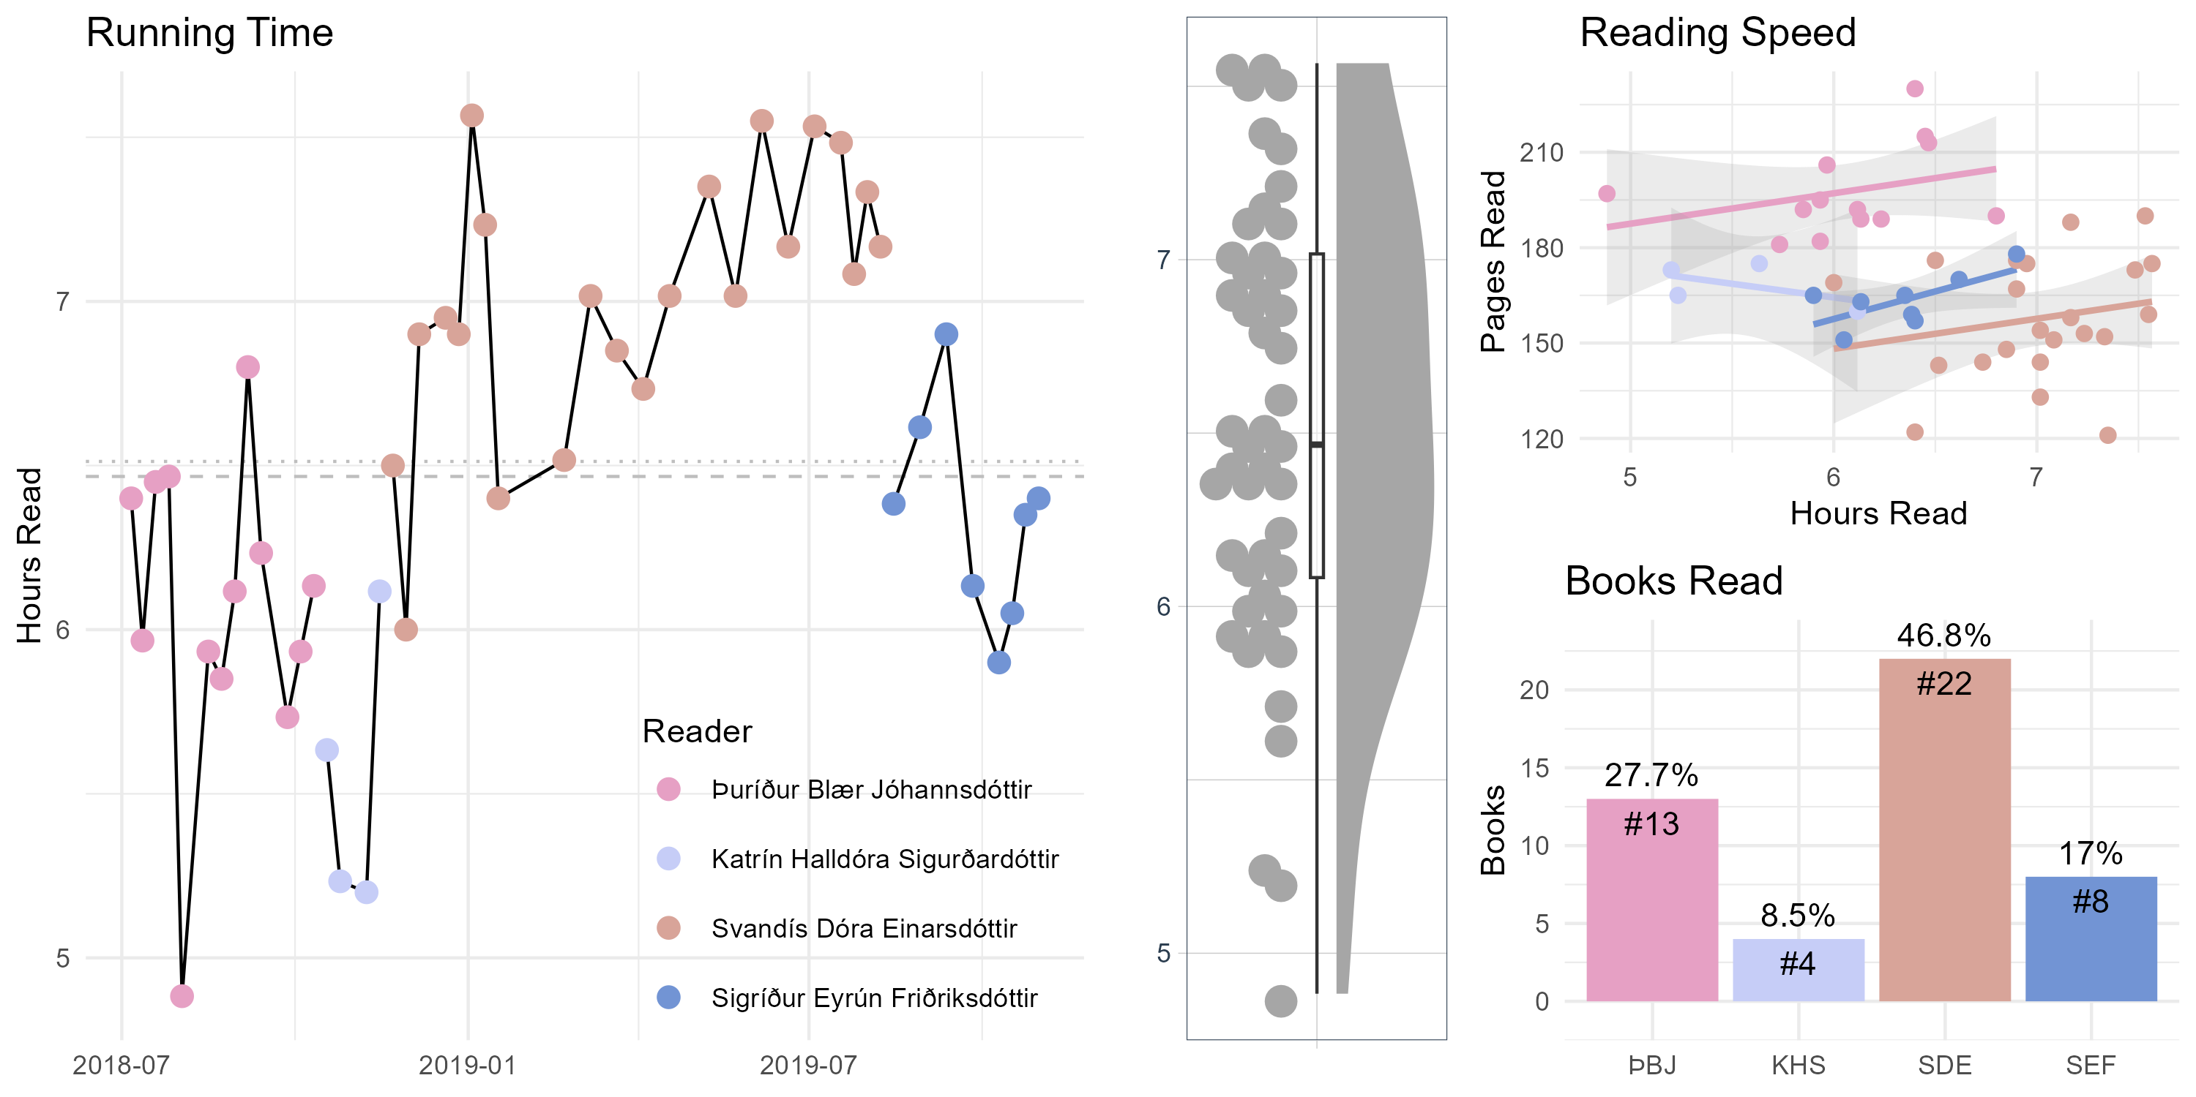
Audiobooks on Storytel: Our Narrators
Over 18K min of romantic medieval fantasy – 12.8 days of cont. listening
Four distinct voices with varied styles & perseverance with Margit’s prose

Slide 23
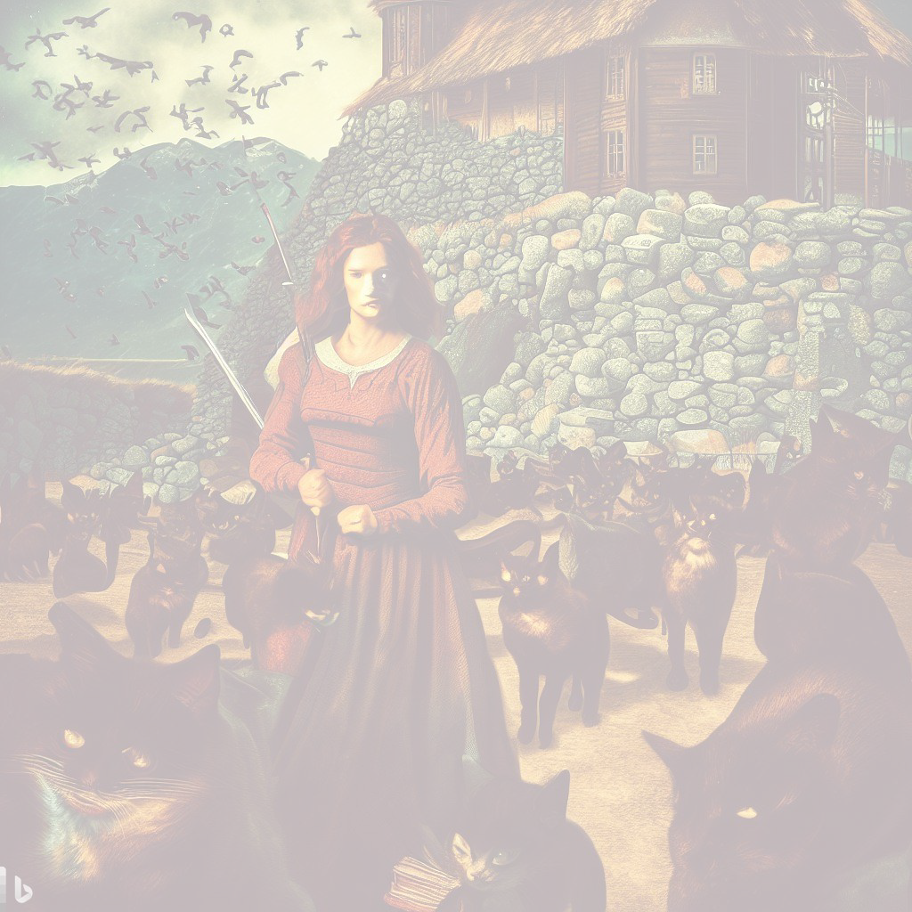
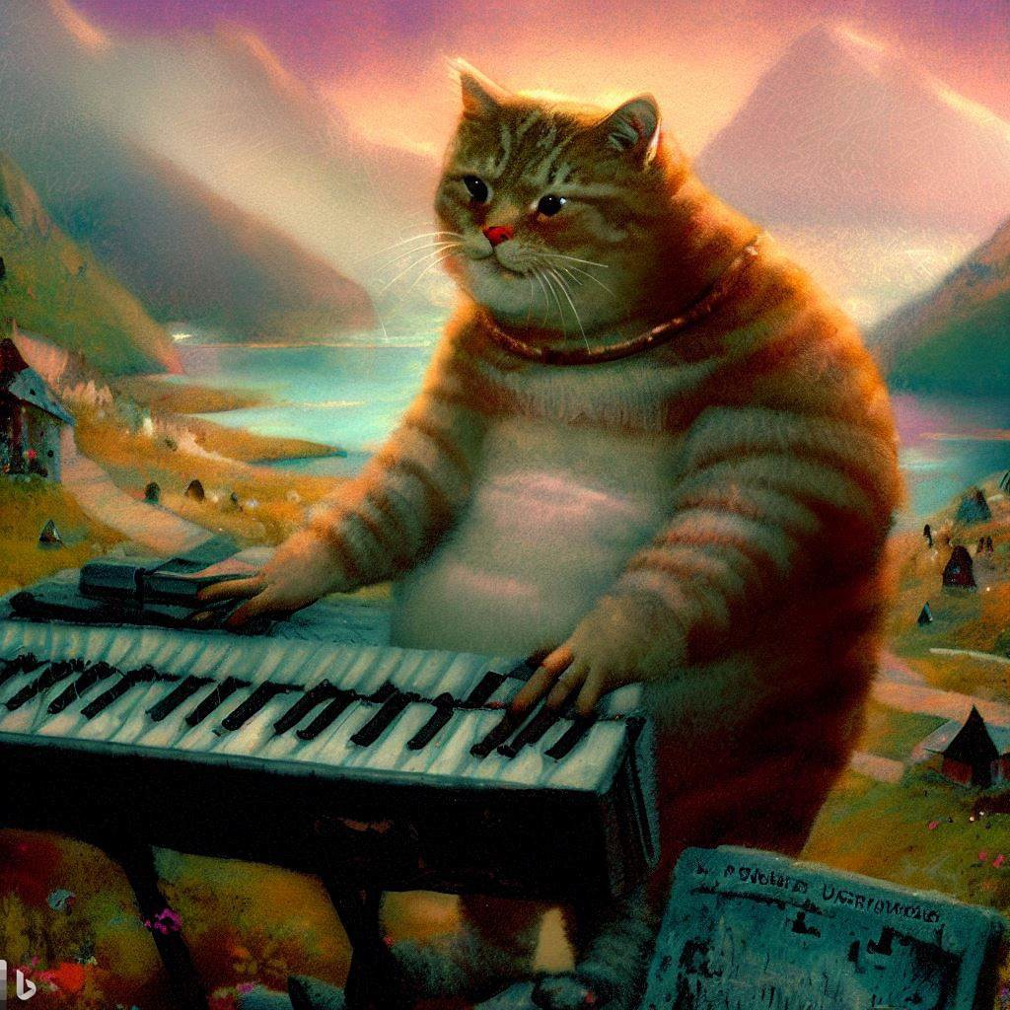
Play Him Off, Keyboard Cat
Feel free to contact me at helgaingim@hi.is or @tungufoss on Twitter.
Get the source of this data analysis at:
github.com/tungufoss/ iskisur-rek-data-beers
cba

